Slide 1
Data Extract Creation Tool Training
Notes:
Welcome to the Data Extract Creation Tool Training presentation. This presentation will cover the basics of utilizing the Data Extract Creation Tool to add employees, not previously captured in your extract, to your CWB.

Slide 2
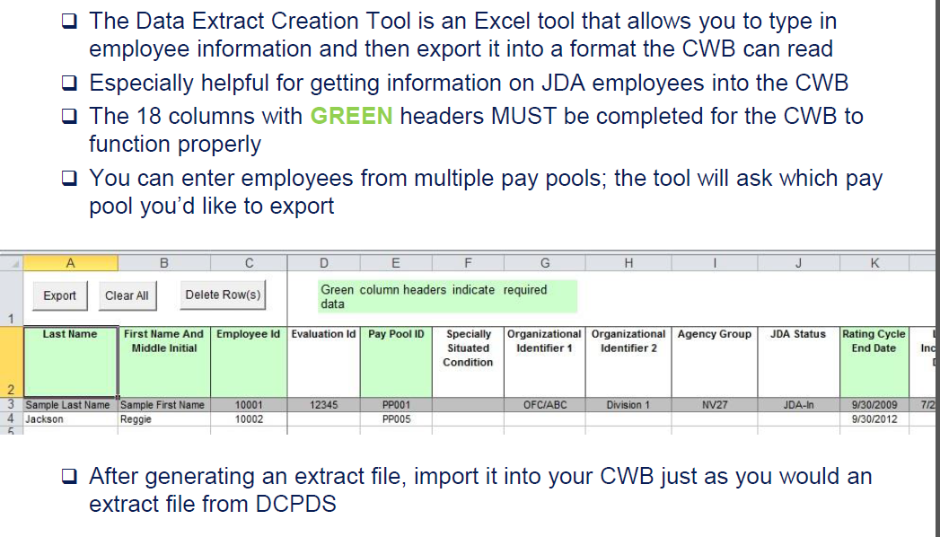
Data Extract Creation Tool
Notes:
If you discover that one or more employees are not present, you should try to determine why they are missing and take the appropriate action:
Reasons why an employee is not in the extract – Employee came on board after the date of extract; Employee was not assigned to the pay pool at the time of extract due to incorrect pay pool ID; Employee transferred from one agency to another and the employee's personnel action for the transfer has not been processed yet.
If you encounter a situation where a given employee should be considered for a bonus in your pay pool (and you are certain that they are not being considered in any other pay pool), you can use the Data Extract Creation Tool to manually create a record for the employee and import their record into the CWB.
The remaining slides in this presentation will give instructions on how to use the Data Extract Creation Tool and how to import the records into the CWB.

Slide 3
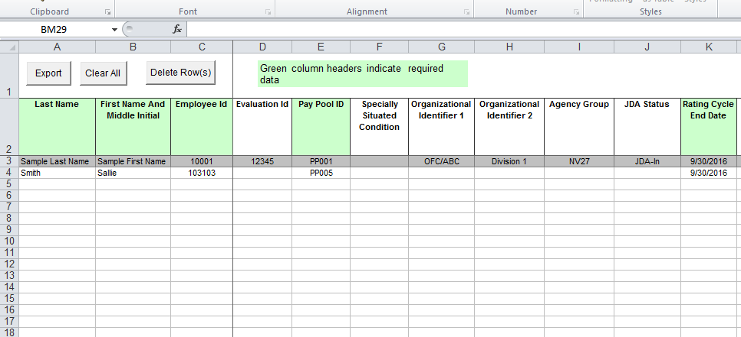
To add an employee, fill in all the cells highlighted in green
Notes:
To add a missing employee, fill in all the cells that are highlighted in green.

Slide 4
When all the green cells are filled, click on the “Export” tab at the top
Notes:
When all of the green cells are filled, click on the “Export” tab at the top.

Slide 5
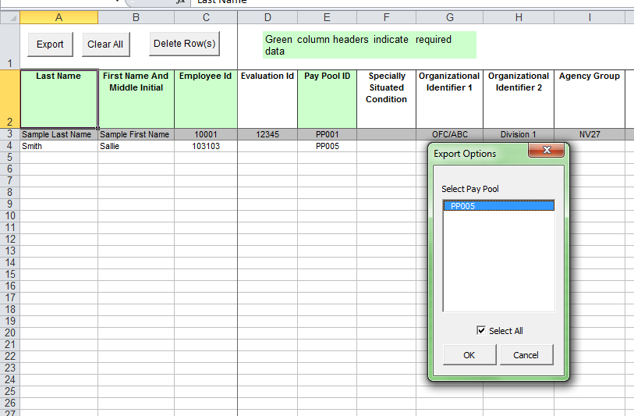
Click OK
Notes:
Click okay to export data.

Slide 6
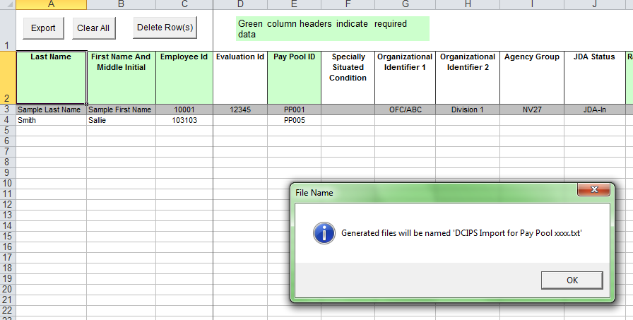
Click OK
Notes:
Program generates an import file with a system-generated name.

Slide 7
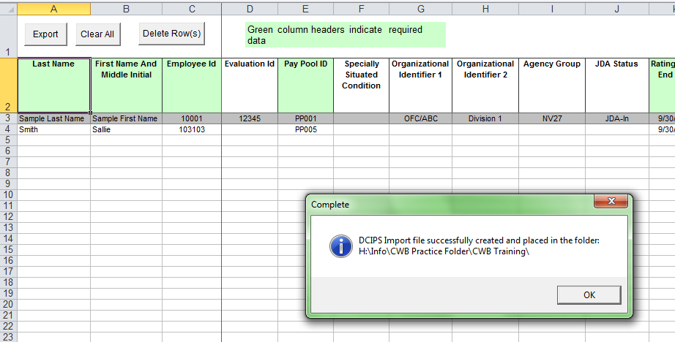
Click OK
Notes:
Program shows you the location of the import file.

Slide 8
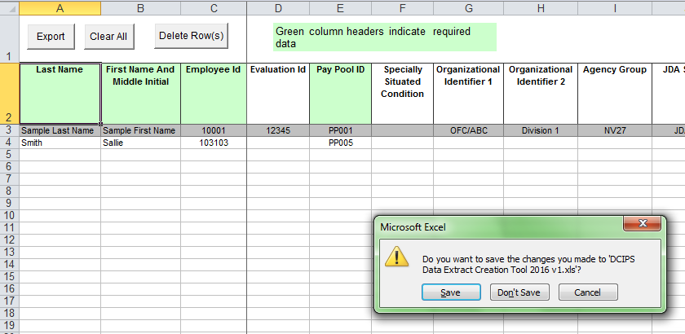
Close out program. The export is already saved in your CWB Folder, as the prior slide confirmed. Choose “Don’t Save”
Notes:
Program has already saved your import file, so there is no need to save the changes to the DCIPS Data Extract Creation Tool.

Slide 9
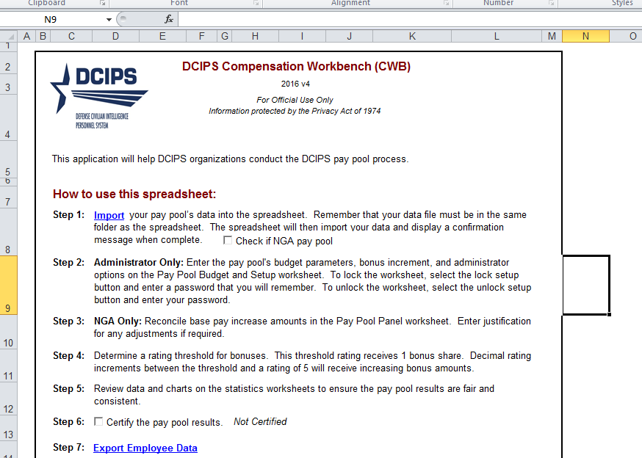
Open the CWB that already has your other employees populated in the cells. Click on the “Import” link highlighted in blue.
Notes:
Open the CWB that already contains the names and information for your other employees. Click the “Import” link located in Step 1.

Slide 10
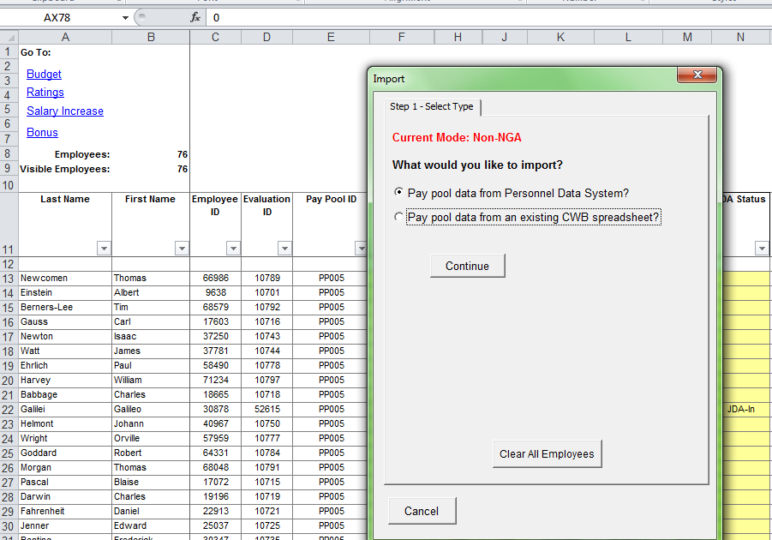
Choose the “Pay pool data from Personnel Data System?” tab. Click on the “Continue” tab.
Notes:
Choose the “Pay pool data from Personnel Data System”, and click on the Continue tab.

Slide 11
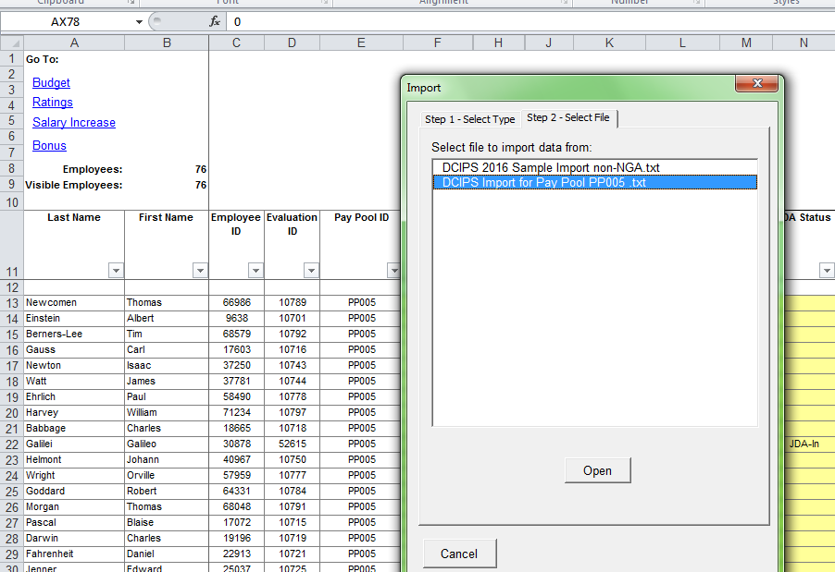
Choose the correct “.txt file”. Click on the Open tab.
Notes:
Highlight the DCIPS Import txt file and click the Open tab.

Slide 12
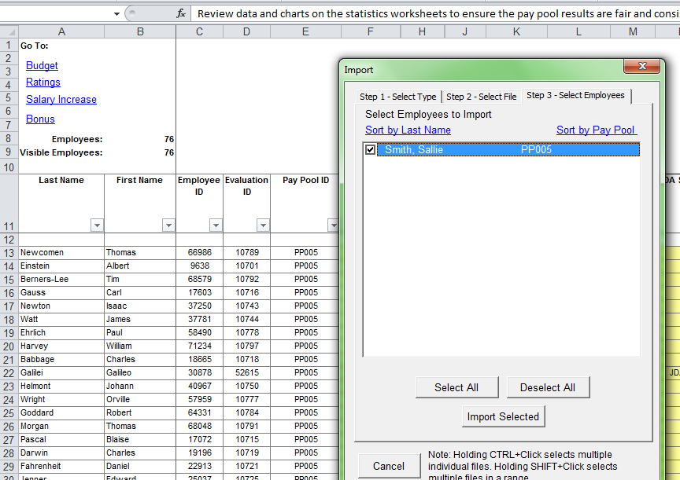
Choose “Select All” tab to highlight the name or click in the box next to the name. Next click on “Import Selected” tab.
Notes:
Choose “Select All” tab to highlight the employee’s name or click in the box next to the name. Click on “Import Selected” tab.

Slide 13
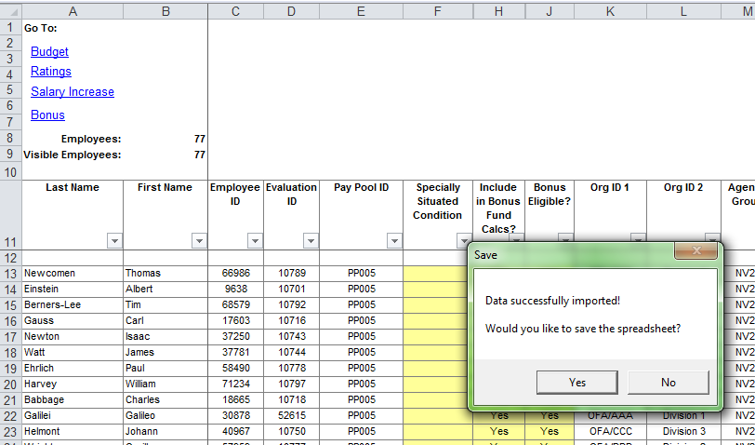
Click on the “Yes” tab to save the spreadsheet.
Notes:
Click on the “Yes” tab to save the spreadsheet.

Slide 14
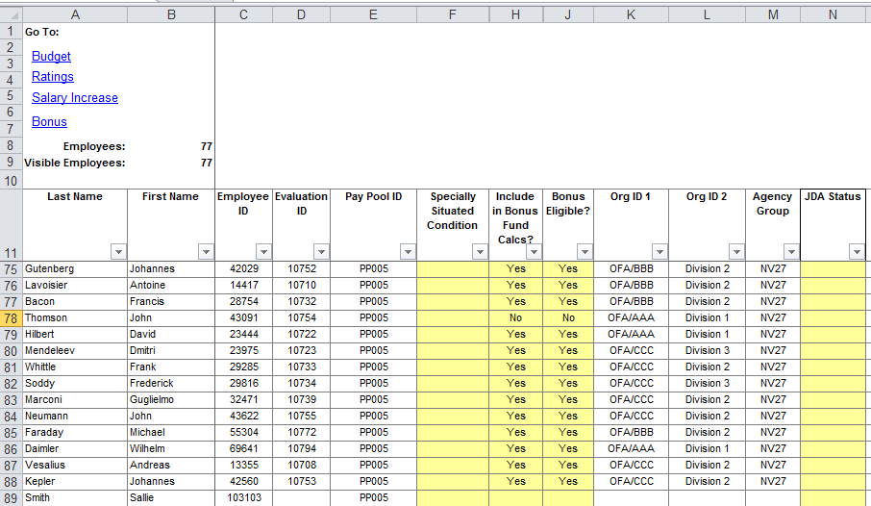
Check to ensure that the member has been added.
Notes:
Check CWB to ensure that the employee has been added. Continue with Pay Pool deliberations outlined in the CWB User Guide.

Slide 15
Point of Contact
Remember to read the following guides and practice using the CWB Tool with the DCIPS CWB test data:
DCIPS CWB Extract & Upload-Payout Processes User Guide
DCIPS CWB User Guide
DCIPS DPAT User Guide
Contact Information:
Phone number: 703-692-3706
Email: Olufemi.o.adebiyi.ctr@mail.mil
Notes:
This concludes the training presentation.
Remember to read the DCIPS CWB Extract & Upload-Payout Processes User Guide, DCIPS CWB User Guide, and DCIPS DPAT User Guide. Utilize the CWB tool with the CWB test data to practice using the CWB tool to make bonus decisions. For any questions, contact Femi at the email or phone number listed here.

